Slide 1

제17강 뷰(View)와 레이아웃-3
3. 뷰와 레이아웃 실습
1) 버튼 뷰
2) 텍스트 뷰
3) 리니어 레이아웃
학습 목표
View 클래스의 기본 위젯을 이해한다.
기본 위젯을 다루는 방법을 실습한다.
UI관점에서 안드로이드 View와 레이아웃을 설계한다.

Slide 2
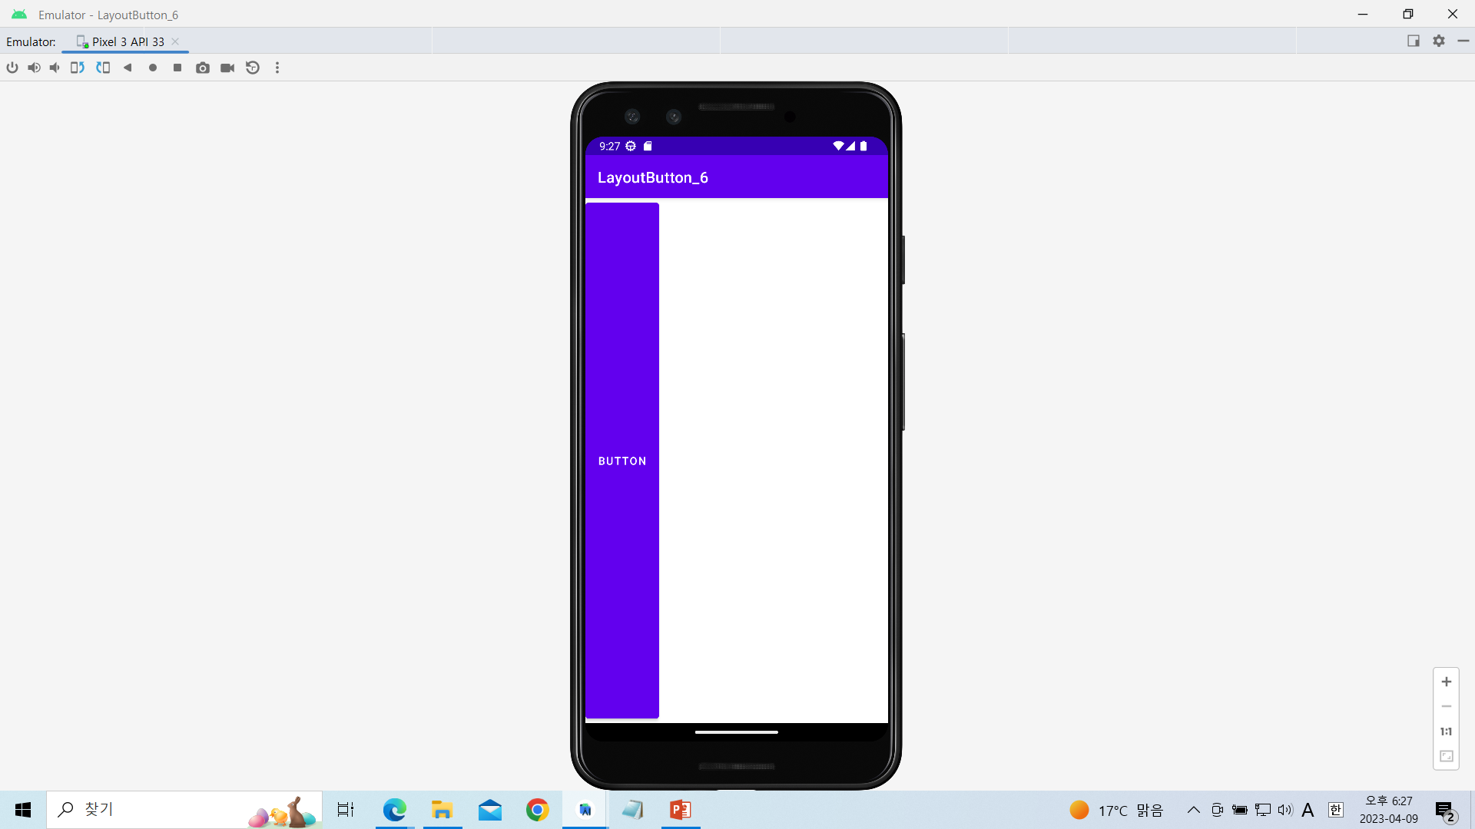
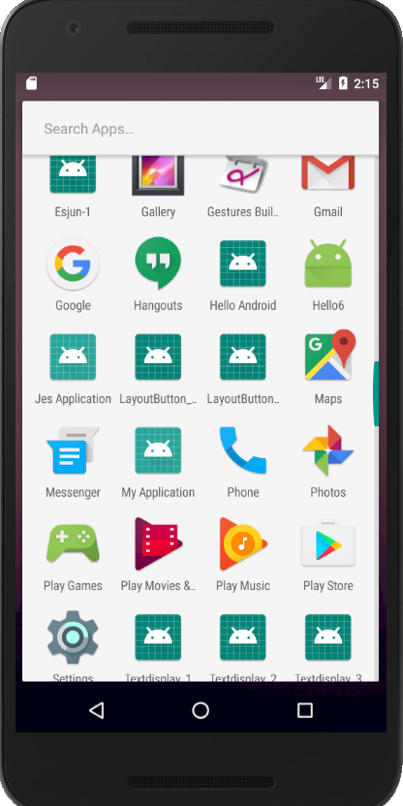
LayoutButton_6과제실습

Slide 3
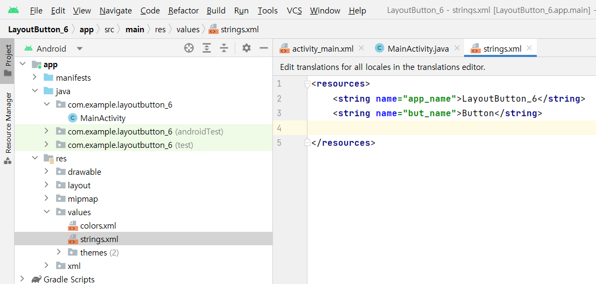
[string.xml]

Slide 4
<resources>
<string name="app_name">LayoutButton_6</string>
<string name="but_name">Button</string>
</resources>

Slide 5
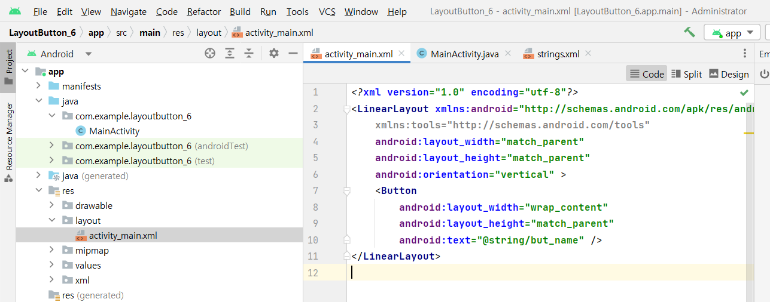
[activity_main.xml]

Slide 6
[activity_main.xml]
<?xml version="1.0" encoding="utf-8"?>
<LinearLayout xmlns:android="http://schemas.android.com/apk/res/android"
xmlns:tools="http://schemas.android.com/tools"
android:layout_width="match_parent"
android:layout_height="match_parent"
android:orientation="vertical" >
<Button
android:layout_width="wrap_content"
android:layout_height="match_parent"
android:text="@string/but_name" />
</LinearLayout>

Slide 7
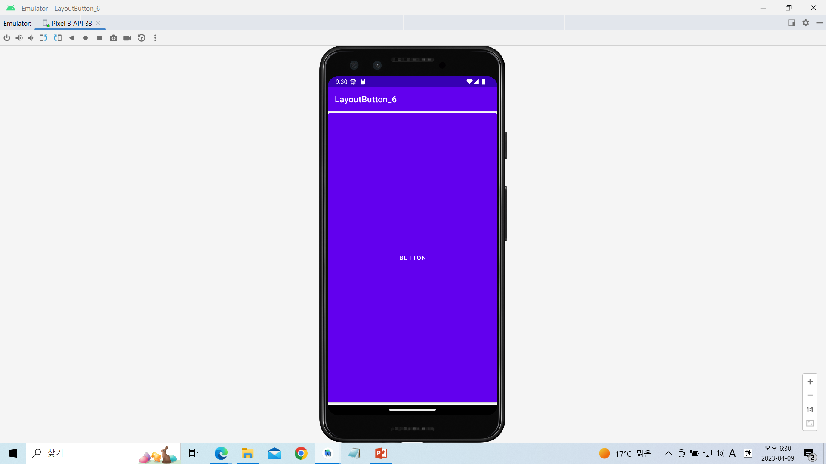
LayoutButton_7과제실습

Slide 8
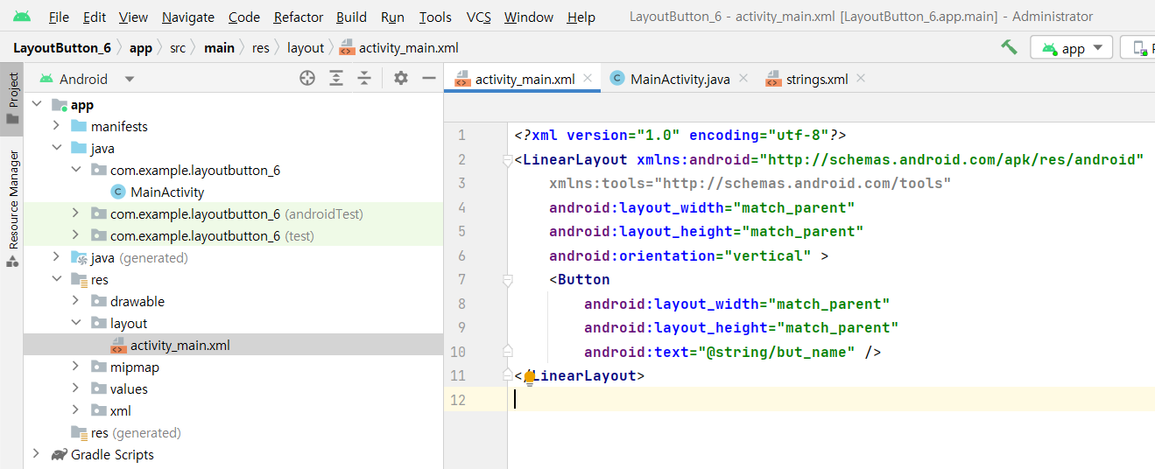
[activity_main.xml]

Slide 9
<?xml version="1.0" encoding="utf-8"?>
<LinearLayout xmlns:android="http://schemas.android.com/apk/res/android"
xmlns:tools="http://schemas.android.com/tools"
android:layout_width="match_parent"
android:layout_height="match_parent"
android:orientation="vertical" >
<Button
android:layout_width="match_parent"
android:layout_height="match_parent"
android:text="@string/but_name" />
</LinearLayout>

Slide 10
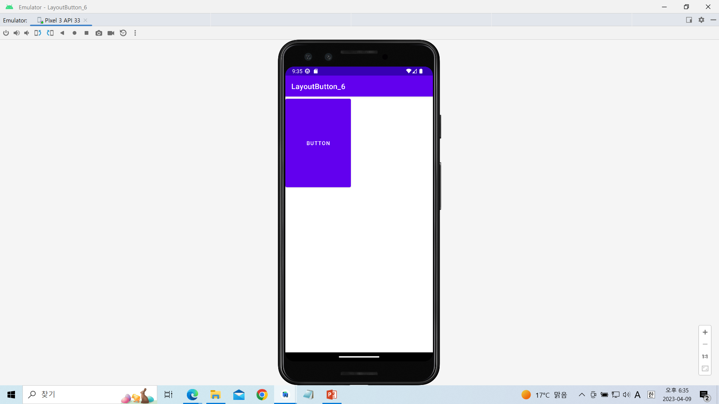
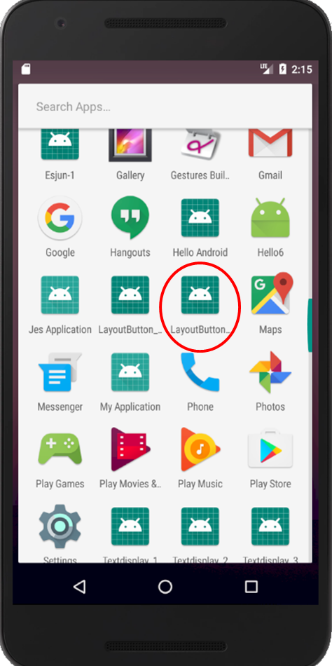
LayoutButton_8과제실습

Slide 11
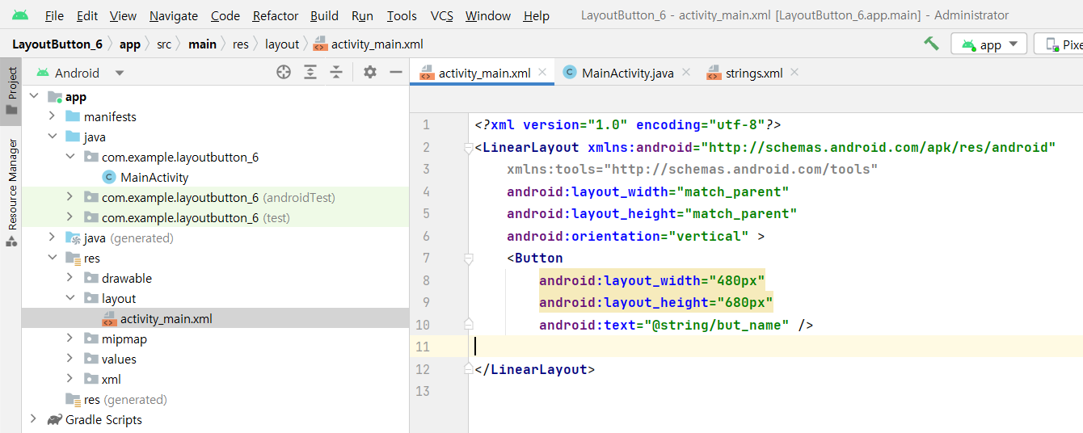
[activity_main.xml]

Slide 12
<?xml version="1.0" encoding="utf-8"?>
<LinearLayout xmlns:android="http://schemas.android.com/apk/res/android"
xmlns:tools="http://schemas.android.com/tools"
android:layout_width="match_parent"
android:layout_height="match_parent"
android:orientation="vertical" >
<Button
android:layout_width="480px"
android:layout_height="680px"
android:text="@string/but_name" />
</LinearLayout>

Slide 13
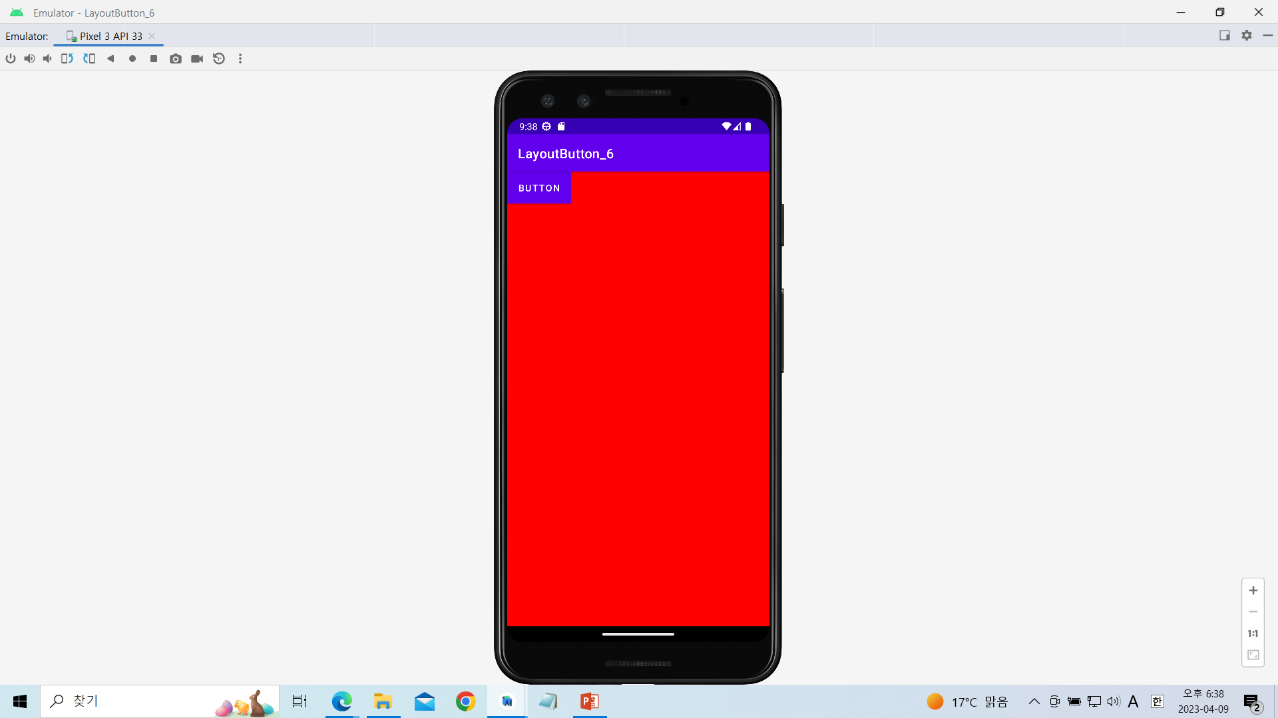
LayoutButton_9과제실습

Slide 14
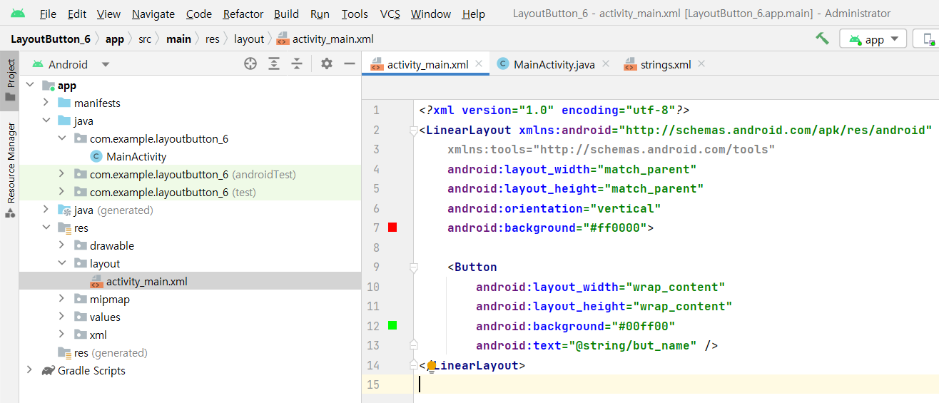
[activity_main.xml]

Slide 15
<?xml version="1.0" encoding="utf-8"?>
<LinearLayout xmlns:android="http://schemas.android.com/apk/res/android"
xmlns:tools="http://schemas.android.com/tools"
android:layout_width="match_parent"
android:layout_height="match_parent"
android:orientation="vertical"
android:background="#ff0000">
<Button
android:layout_width="wrap_content"
android:layout_height="wrap_content"
android:background="#00ff00"
android:text="@string/but_name" />
</LinearLayout>

Slide 16
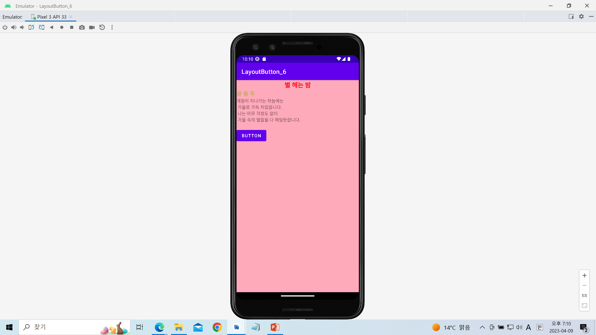
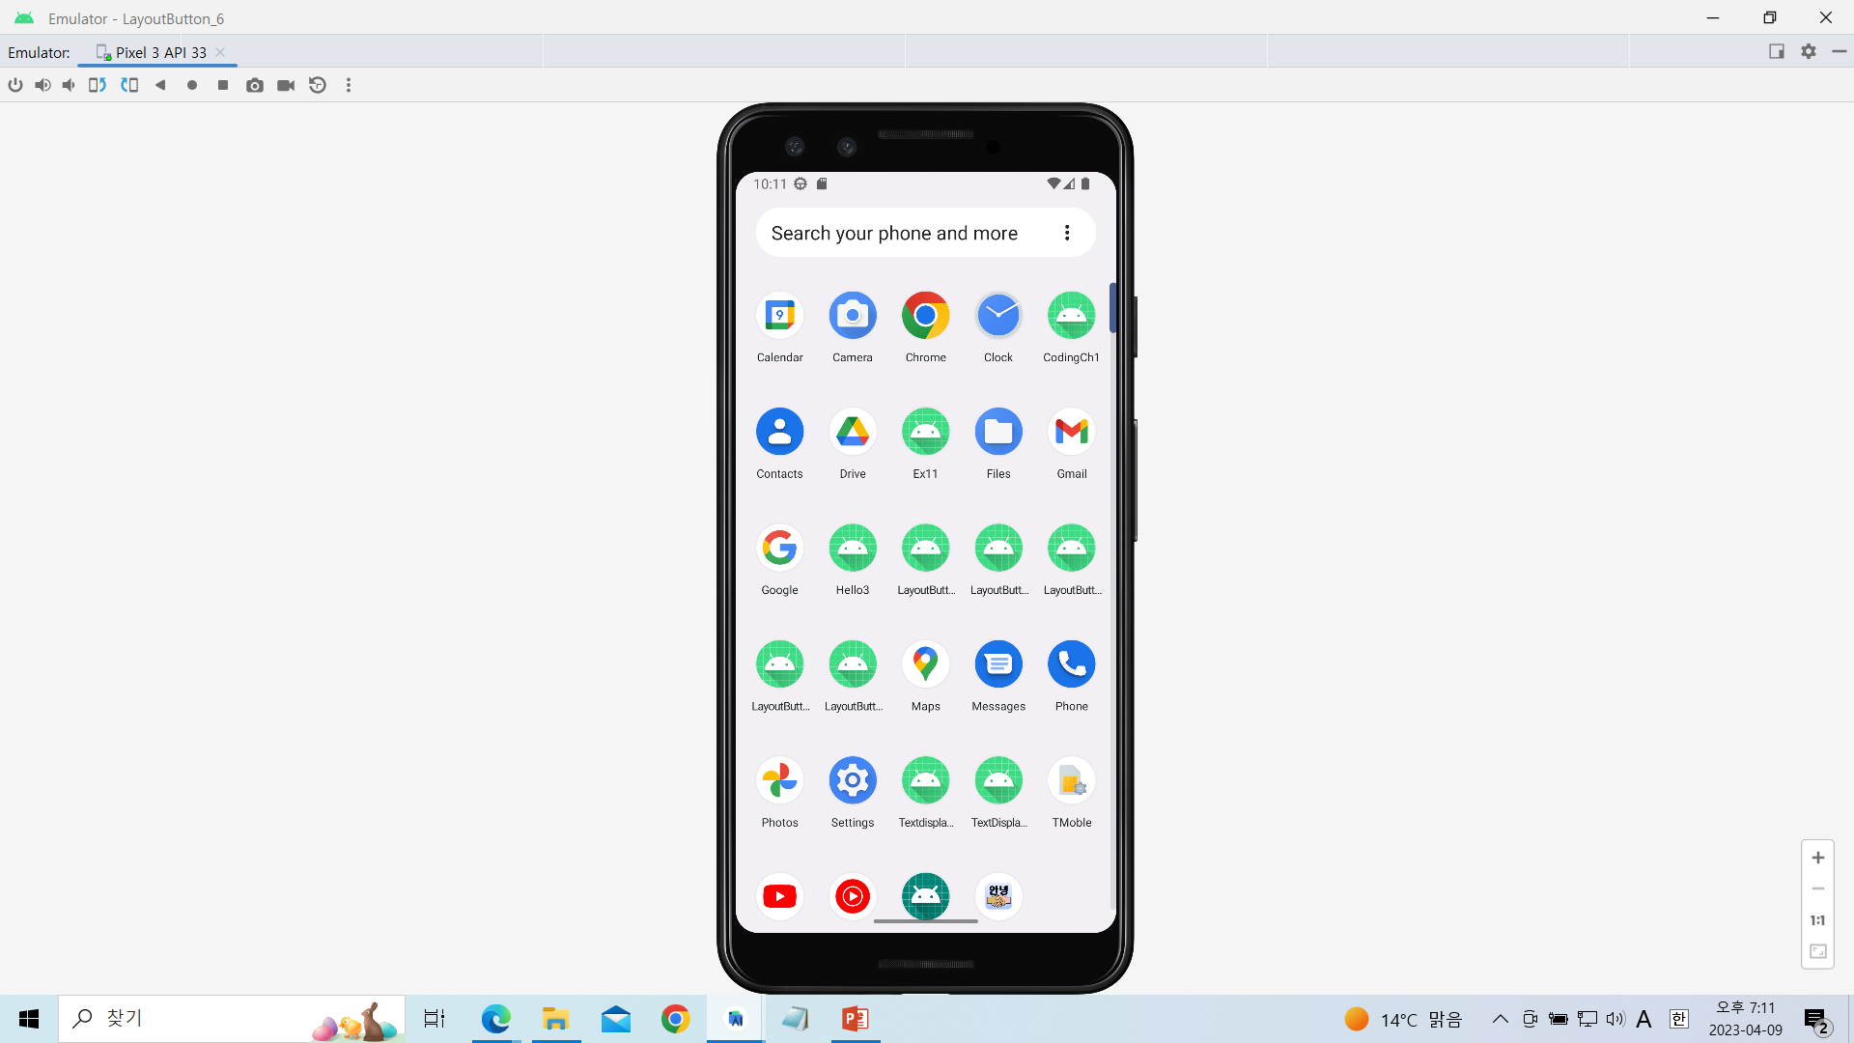
LayoutButton_10과제실습

Slide 17
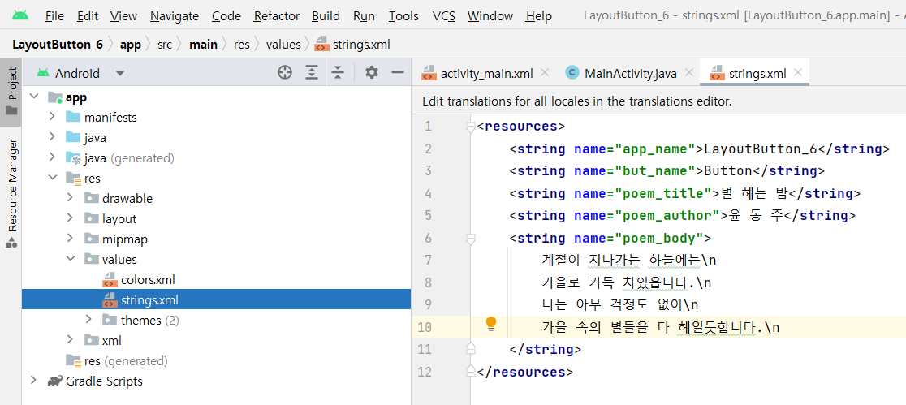
[string.xml]

Slide 18
<resources>
<string name="app_name">LayoutButton_6</string>
<string name="but_name">Button</string>
<string name="poem_title">별 헤는 밤</string>
<string name="poem_author">윤 동 주</string>
<string name="poem_body">
계절이 지나가는 하늘에는\n
가을로 가득 차있읍니다.\n
나는 아무 걱정도 없이\n
가을 속의 별들을 다 헤일듯합니다.\n
</string>
</resources>

Slide 19
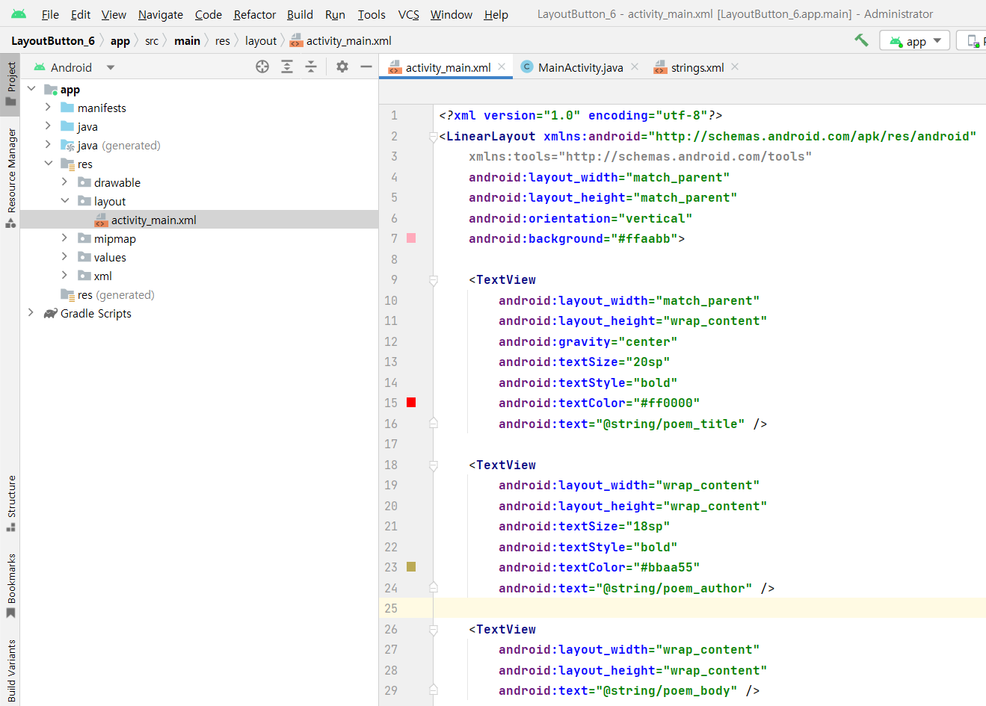
[activity_main.xml]

Slide 20
<?xml version="1.0" encoding="utf-8"?>
<LinearLayout xmlns:android="http://schemas.android.com/apk/res/android"
xmlns:tools="http://schemas.android.com/tools"
android:layout_width="match_parent"
android:layout_height="match_parent"
android:orientation="vertical"
android:background="#ffaabb">
<TextView
android:layout_width="match_parent"
android:layout_height="wrap_content"
android:gravity="center"
android:textSize="20sp"
android:textStyle="bold"
android:textColor="#ff0000"
android:text="@string/poem_title" />

Slide 21
<TextView
android:layout_width="wrap_content"
android:layout_height="wrap_content"
android:textSize="18sp"
android:textStyle="bold"
android:textColor="#bbaa55"
android:text="@string/poem_author" />
<TextView
android:layout_width="wrap_content"
android:layout_height="wrap_content"
android:text="@string/poem_body" />
<Button
android:id="@+id/button1"
android:layout_width="wrap_content"
android:layout_height="wrap_content"
android:text="@string/but_name" />
</LinearLayout>

